Slide 1

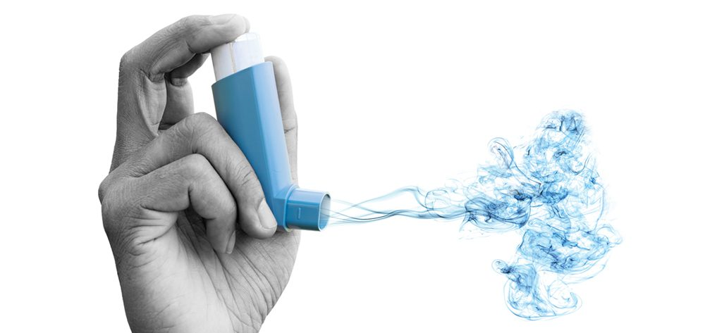

5th December 2023
0
SAMSUNG AI course 2022 @ NOVA University
MYBREATH – Manage Your Breath
A Machine Learning Approach to predict the risk of an emergent admission from people with asthma
Group:
Amin Khodamoradi
Ana Carolina Pádua
Joana Seringa
Zabya Abo Aljadayel

Slide 2


The Problem & The Solution
Emergency department visits from people with asthma, associated with the worsening of the chronic condition.
Elevated Healthcare expenditures
Machine Learning model to predict the risk of an emergent admission from people with asthma
Bad patient experience

Slide 3
Methods
Asthma admissions
Pollen
Weather
Pollution
Random Forest Model
Logistic Regression
SVM
LDA
XGBoost
...
Problem definition
Data Collection
Data Preparation
Model Selection and Implementation
Model Evaluation
Exploratory Data Analysis
Data Cleaning
Feature Engineering
Precision
Recall
F1-score weighted
MSE

Slide 4
Data Collection and Integration
Admission Data
Hospital Sao Francisco Xavier
#1,762 URG asthma admissions from first of January 2019 to 29 November 2022
We excluded data after March 2020 to 2022, because of COVID-2019
Weather data
Extraction the respective data directly from the website.
Pollution data
Extraction the respective files directly from the website.
Pollen data
We created a dedicated script that used beatifullsoap for pulling data out of
Data Integration
Data from admissions, pollen, weather and pollution were integrated in a single file, based on date (weather).

Slide 5
Data Cleaning
Elimination of variables with more than 30% of missing values
Pollution data: replacement of missing values with zeros
Elimination of other variables that were not relevant for the problem under analysis or had the same value for all the episodes.

Slide 6
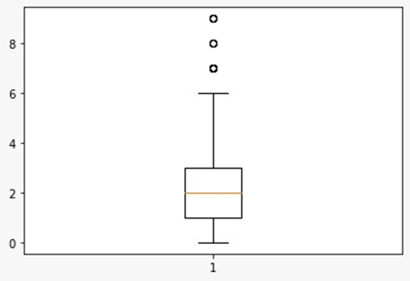
Exploratory Data Analysis
Number of Admissions | Number of days
0 | 126
1 | 183
2 | 180
3 | 133
4 | 82
5 | 45
6 | 24
7 | 9
8 | 3
9 | 4
Admission number box plot
Daily distribution of the number of admissions
Defining the problem as classification with two target level of low (<=2), high (>2)

Slide 7
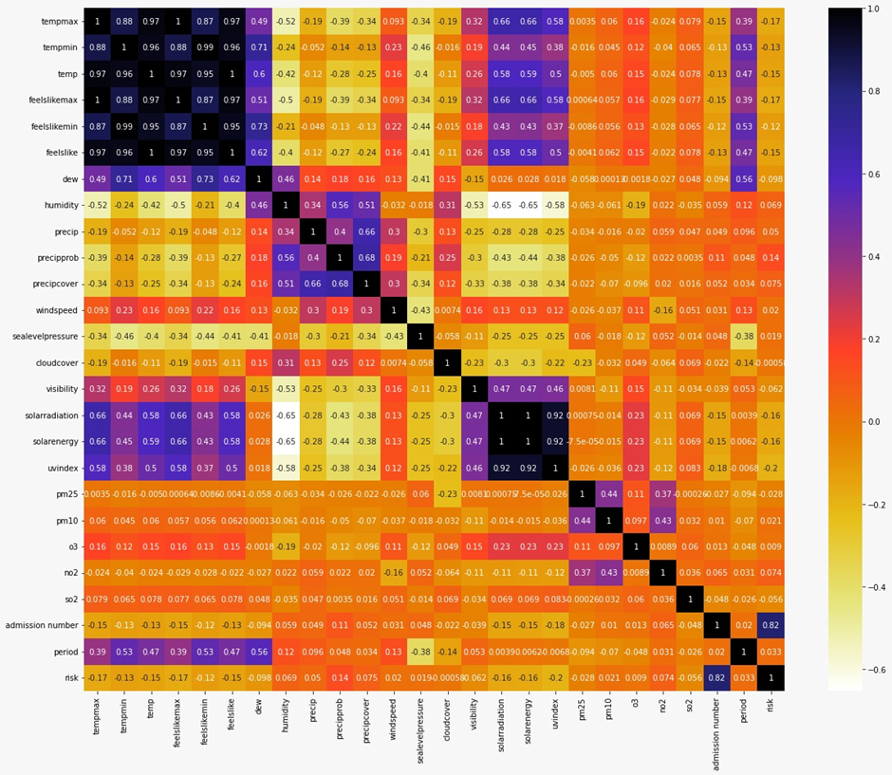
Exploratory Data Analysis
Correlation table

Slide 8
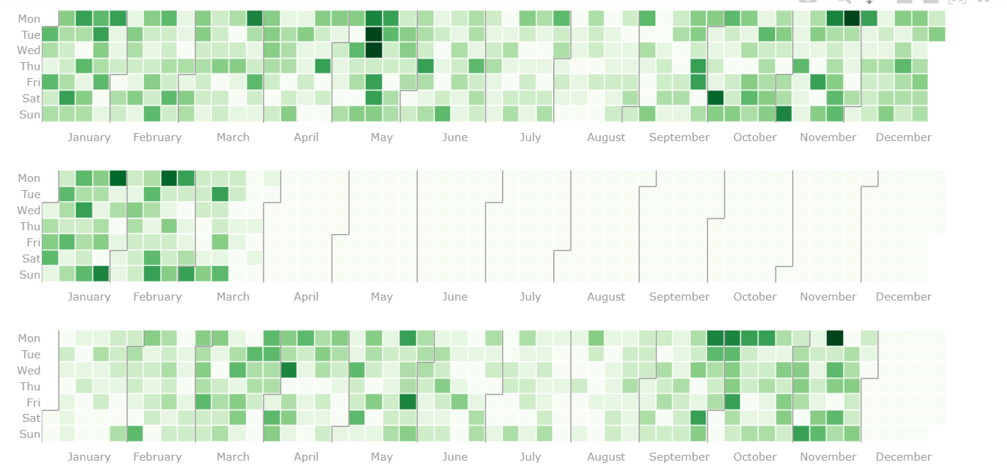
Exploratory Data Analysis
Admission
number

Slide 9
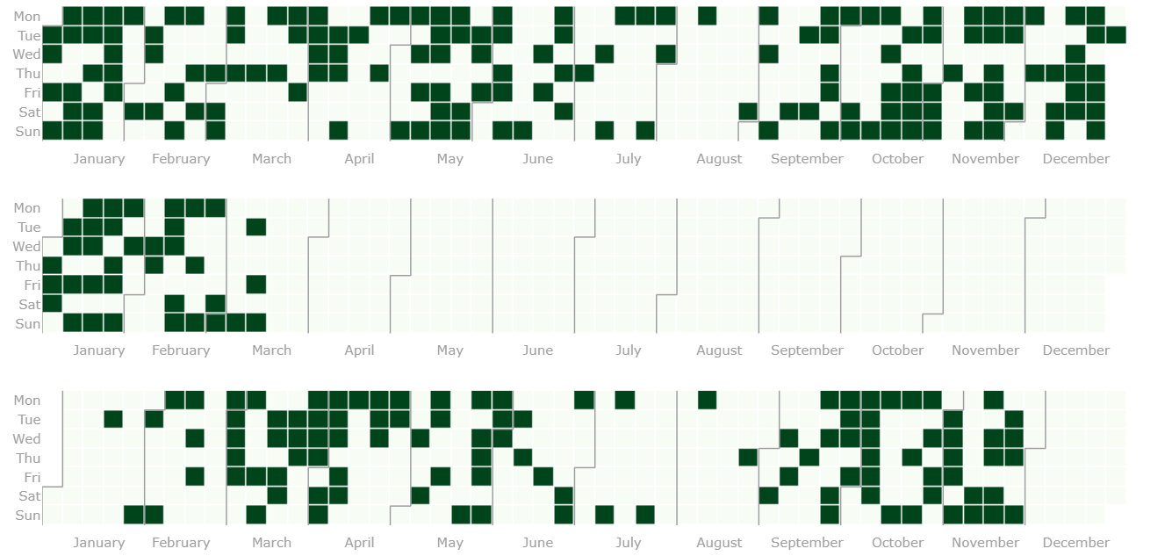
Exploratory Data Analysis
Risk
level

Slide 10
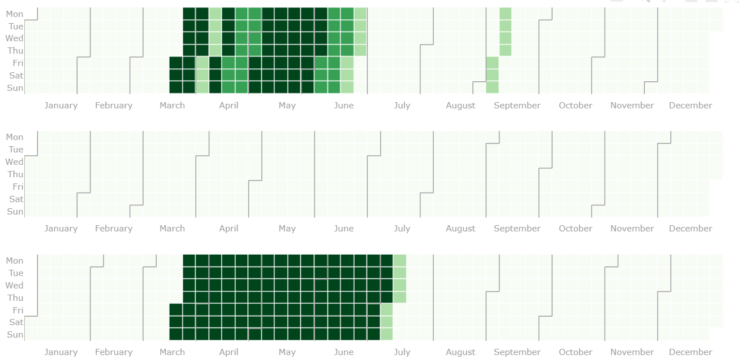
Exploratory Data Analysis
Pollen
Data

Slide 11
Feature Engineering
Data split
Dataset: TimeSeries
Training set: 80 %
Test set: 20 %
Training set
Validation set
Training set
Validation set
Training set
Validation set

Slide 12
Feature Engineering
Feature Selection
Stepwise feature selection: (backward and forward), implemented on R (file named Stepwise feature selection(backward and forward).R)
Mutual Information: which is a quantity that measures a relationship between two random variables that are sampled simultaneously, and that showed no linear correlation.
L1-based feature selection: which removes features with low variance.

Slide 13
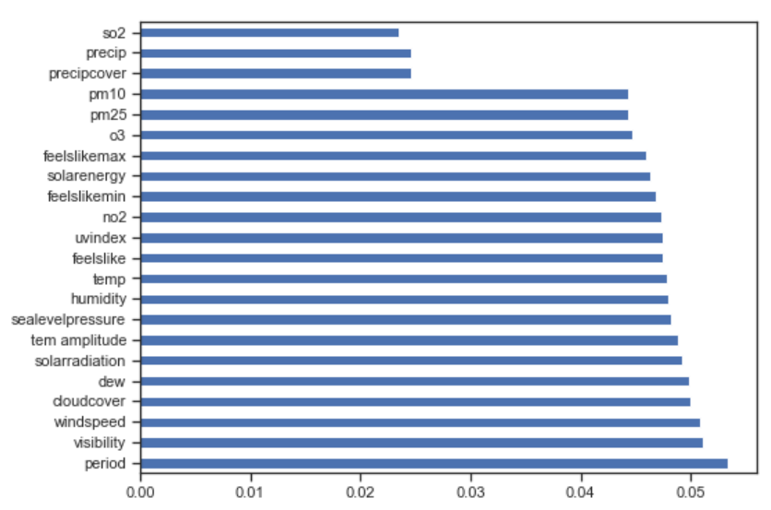
Feature Engineering
Feature Selection
● Chi-square test, which is a statistical hypothesis test used when the sample sizes are large to examine whether two categorical variables are independent in influencing the test statistic. We evaluated that based on the F_score and p value.
● Extra tree feature importance to decide which variables are important to be included in the model.
After trying all the methods mentioned above we selected the Chi-square test with criteria of p-value < 0.05.

Slide 14

Input Variables
Weather
Pollution
Precipprob
Solarradiation
Precipcover
Precip
So2
Pm25
UVindex
8. Feelslikemax
9. No2
10. Feelslike
11. Humidity
12. Temp
13. Feelslikemin
14. Tem amplitude
Output: Number of asthma admissions

Slide 15
Classification
We explored several ML algorithms for supervised learning: Logistic Regression Decision Tree (DT) Linear Discriminant Analysis Gaussian Naive Bayes Support Vector Machines (SVM) Random Forest Sklearn Gradient Boosting XGBoost Classifier XGBoost Random Forest Classifier

Slide 16
Clustering
We explored several ML algorithms for Unsupervised learning: K-means Birch DBSCAN

Slide 17
Regression
We explored several ML algorithms for Regression: Linear Regression Decision Tree Regression (DT) Random Forest Regression XGBoost Regression XGBoost Random Forest Regression

Slide 18
Model tuning
GridSearchCV for model parameters optimizations
Model | Best score and best parameter(s)
Gaussian Naive Bayes | f1_weighted: 0.555 Config: {'var_smoothing': 0.8111308307896871}
Linear Discriminant Analysis | f1_weighted: 0.574 Config: {'shrinkage': 0.01, 'solver': 'lsqr'}
Decision Tree | f1_weighted: 0.593 Config: {'criterion': 'entropy', 'max_depth': 18, 'max_features': 9, 'min_samples_leaf': 1, 'min_samples_split': 2}
SVC model | f1_weighted: 0.563 C': 100, 'gamma': 1, 'kernel': 'linear'}
Logistic Regression | f1_weighted: 0.571 Config: {'C': 100, 'max_iter': 100, 'penalty': 'l2', 'solver': 'lbfgs'}
F1_score = 2 x (Precision x Recall) / Precision + Recall
Notes:
F1 score was the scoring used. It is the harmonic mean of precision and recall.
var_smoothing is a stability calculation to widen (or smooth) the curve and therefore account for more samples that are further away from the distribution mean.

Slide 19
Model tuning
GridSearchCV for model hyperparameters optimizations
Model | Best score and best parameter(s)
Gradient Boosting | f1_weighted: 0.589 Config: {'learning_rate': 1, 'max_depth': 5, 'max_features': 9, 'n_estimators': 150}
XGBoost Classifier | f1_weighted: 0.536 Config: {'learning_rate': 1, 'max_depth': 6, 'n_estimators': 200}
RFXGBoost Classifier | f1_weighted: 0.570 Config: {'learning_rate': 1, 'max_depth': 1, 'n_estimators': 300}
Random Forest | f1_weighted: 0.539 Config: {'bootstrap': False, 'max_depth': 9, 'max_features': 'auto', 'n_estimators': 200}
F1_score = 2 x (Precision x Recall) / Precision + Recall
Notes:
F1 score was the scoring used. It is the harmonic mean of precision and recall.
var_smoothing is a stability calculation to widen (or smooth) the curve and therefore account for more samples that are further away from the distribution mean.

Slide 20
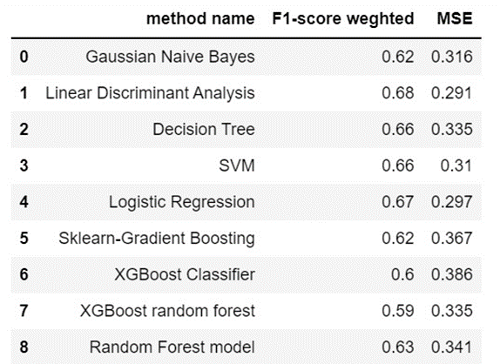
Results

Slide 21
Discussion
Limitations
Data quality - once real-world settings are more likely to lead to reduced data quality. Low sample size related to the fact that we only used information from one hospital Data available from the period of april 2020 to december 2021, inclusive, could not be used, because the number of hospital admissions was highly influenced by the COVID-19 pandemic.

Slide 22
Conclusions
The data analysed does not suggest a direct influence of environment conditions (weather, pollution and pollen) in the risk of hospital admissions due to asthma. This might be due to the fact that the dataset used is limited.

Slide 23
Future Directions
Integrate the machine learning model in an alert system to healthcare professionals and people with asthma considering two levels of risk (low and high risk)
Consider more personal characteristics, not only weather characteristics Collect information from all the country

Slide 24
Thank you!
“Education is the most powerful weapon which you can use to change the world.”
Nelson Mandela
Sponsored by:

